Slide 1
Montgomery Transit Accessibility to New Residential Areas
Krishna C. Mummadi

Slide 2
Introduction
This project evaluates transit accessibility for newly developed residential parcels in Montgomery County, Maryland, with a focus on developments constructed from 2020 onward. Montgomery County was selected due to its status as one of the fastest-growing jurisdictions in the state, reflecting significant recent increases in population.
Its strategic location adjacent to Washington, D.C., combined with ongoing suburban expansion and economic development, has led to heightened demand for reliable and efficient public transportation. Assessing the proximity of new residential development to existing transit infrastructure provides critical insight for urban planning, infrastructure investment, and promoting equitable access to mobility.

Slide 3
Objectives
Identify newly developed residential parcels in Montgomery County built from 2020 onward.
Integrate parcel and transit datasets into a spatially enabled PostgreSQL/PostGIS database.
Evaluate the proximity of new residential parcels to public transit services, including bus (MTA, RideOn) and rail (MARC, AMTRAK, WMATA).
Classify parcels based on their level of transit access using spatial queries and distance thresholds (e.g., 500 meters for bus, 1 mile and 5 miles for rail).
Visualize spatial patterns of accessibility and identify areas lacking sufficient transit coverage.

Slide 4
Data
Parcel Data
Source: Maryland Department of Planning (MDP) – Property View
Type: Point data representing parcel centroids
Purpose: Used to identify newly developed residential parcels (built 2020 and later)
Transit Data
MTA Bus Stops – Public bus stop locations across Maryland
RideOn Bus Stops – Local transit routes specific to Montgomery County
MARC Stations – Maryland Area Regional Commuter rail stations
AMTRAK Stations – National intercity rail service
WMATA Stations – Washington Metro system stations serving the D.C. region
Administrative Boundaries
County Boundaries – Sourced from official Maryland boundary datasets
Census Tracts
Coordinate Reference System
All spatial data projected to NAD83 / Maryland State Plane (EPSG:26985) for consistency and accurate spatial analysis

Slide 5
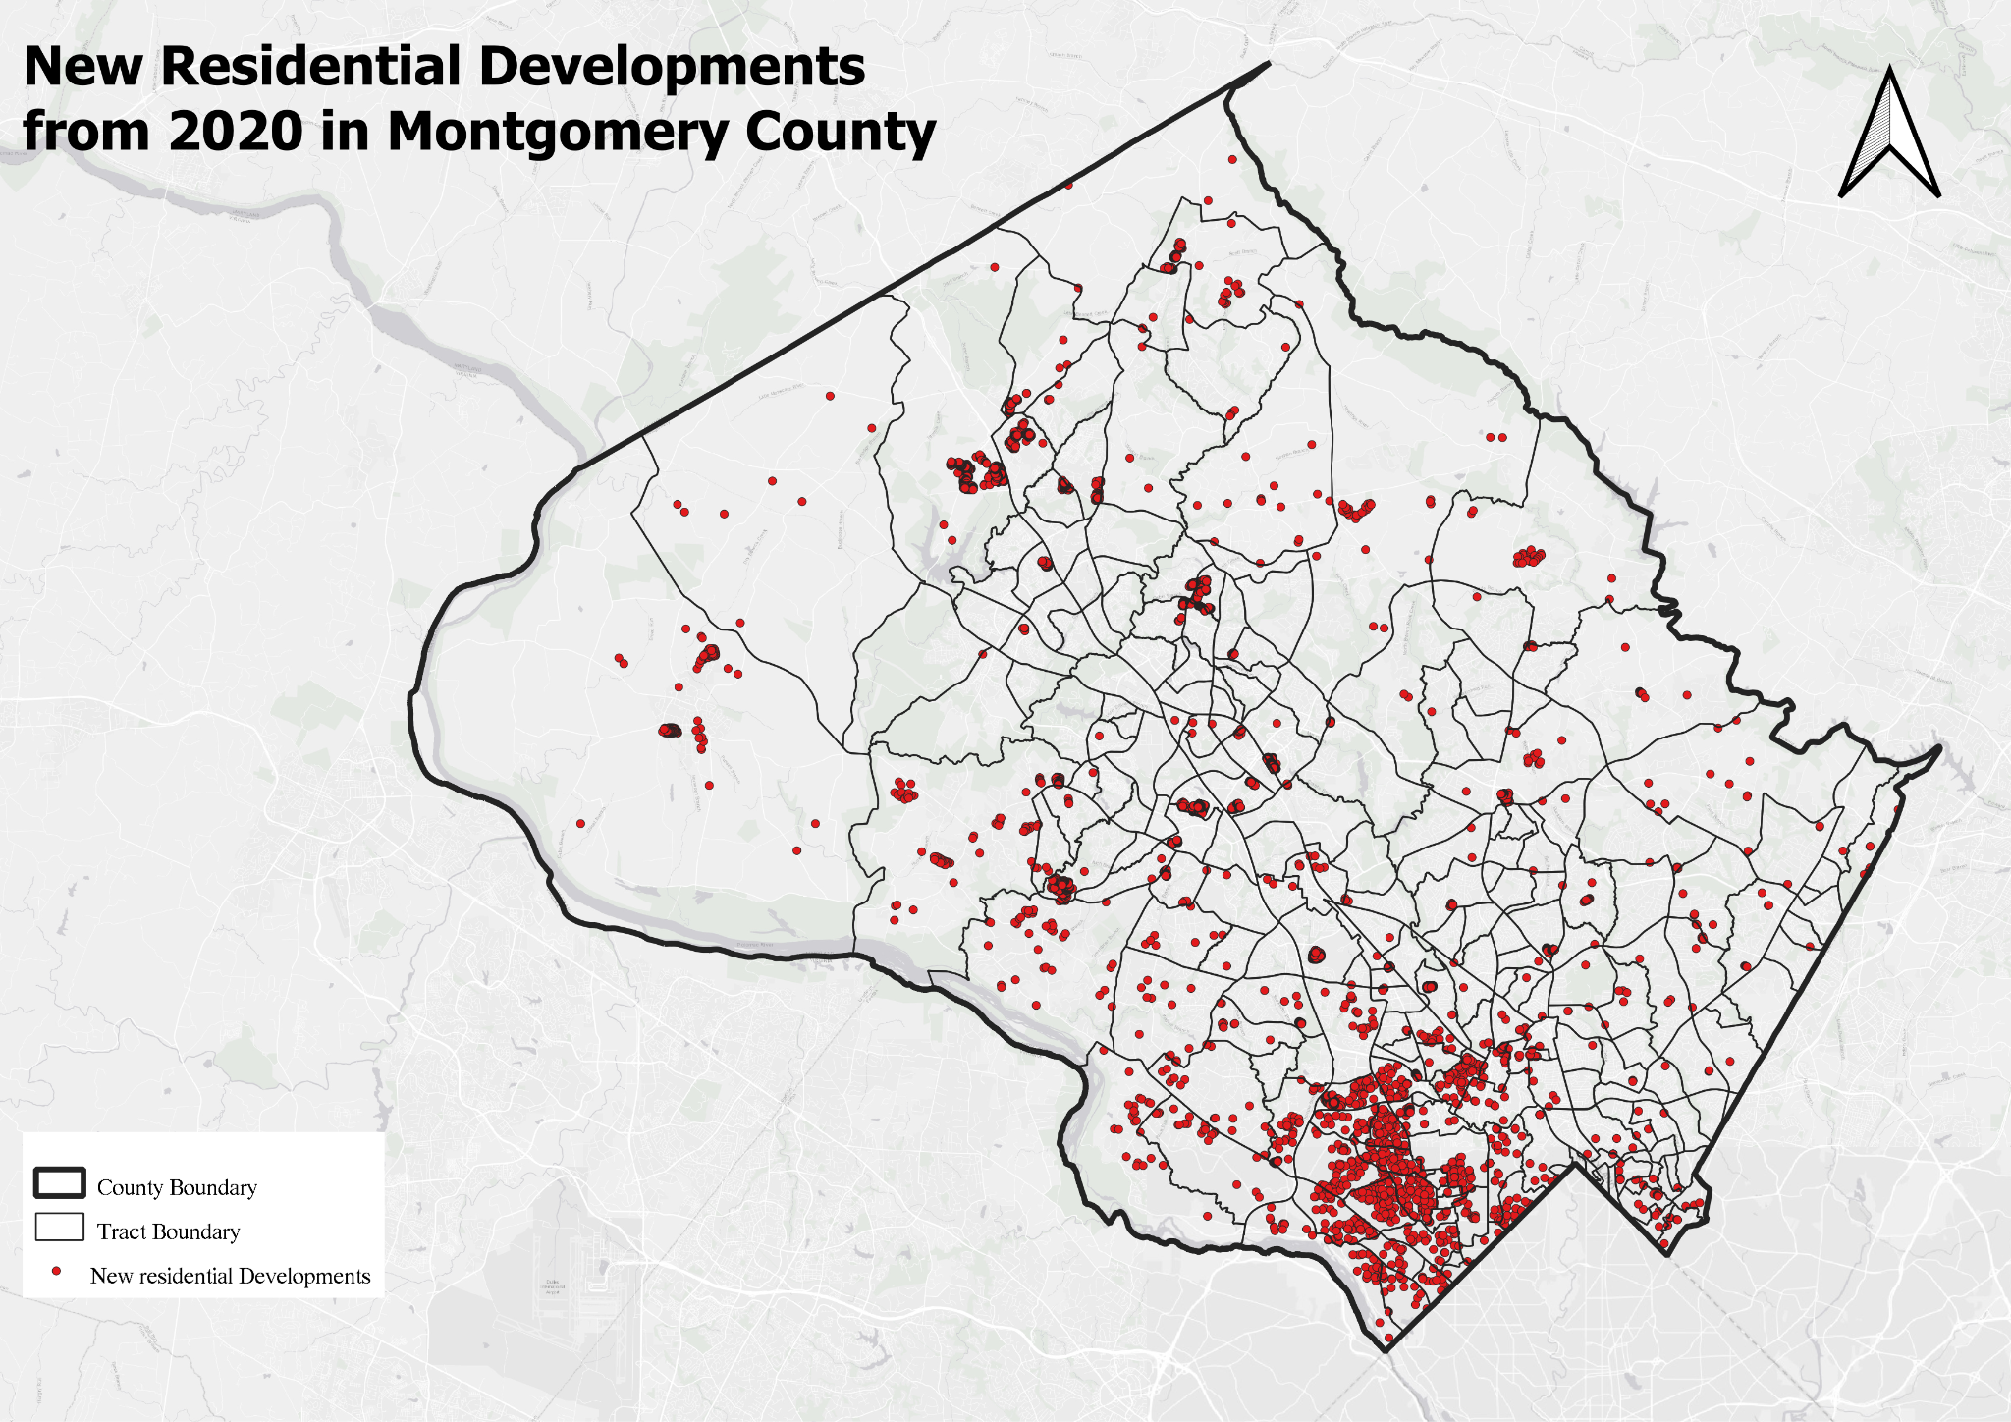
This map displays residential parcels developed since 2020 in Montgomery County. The spatial pattern shows a concentration of new development near the Washington, D.C. border, indicating spatial dependence driven by proximity to the capital and its economic and infrastructural influence.
Total Parcels: 348,587
New Developments: 6,376

Slide 6
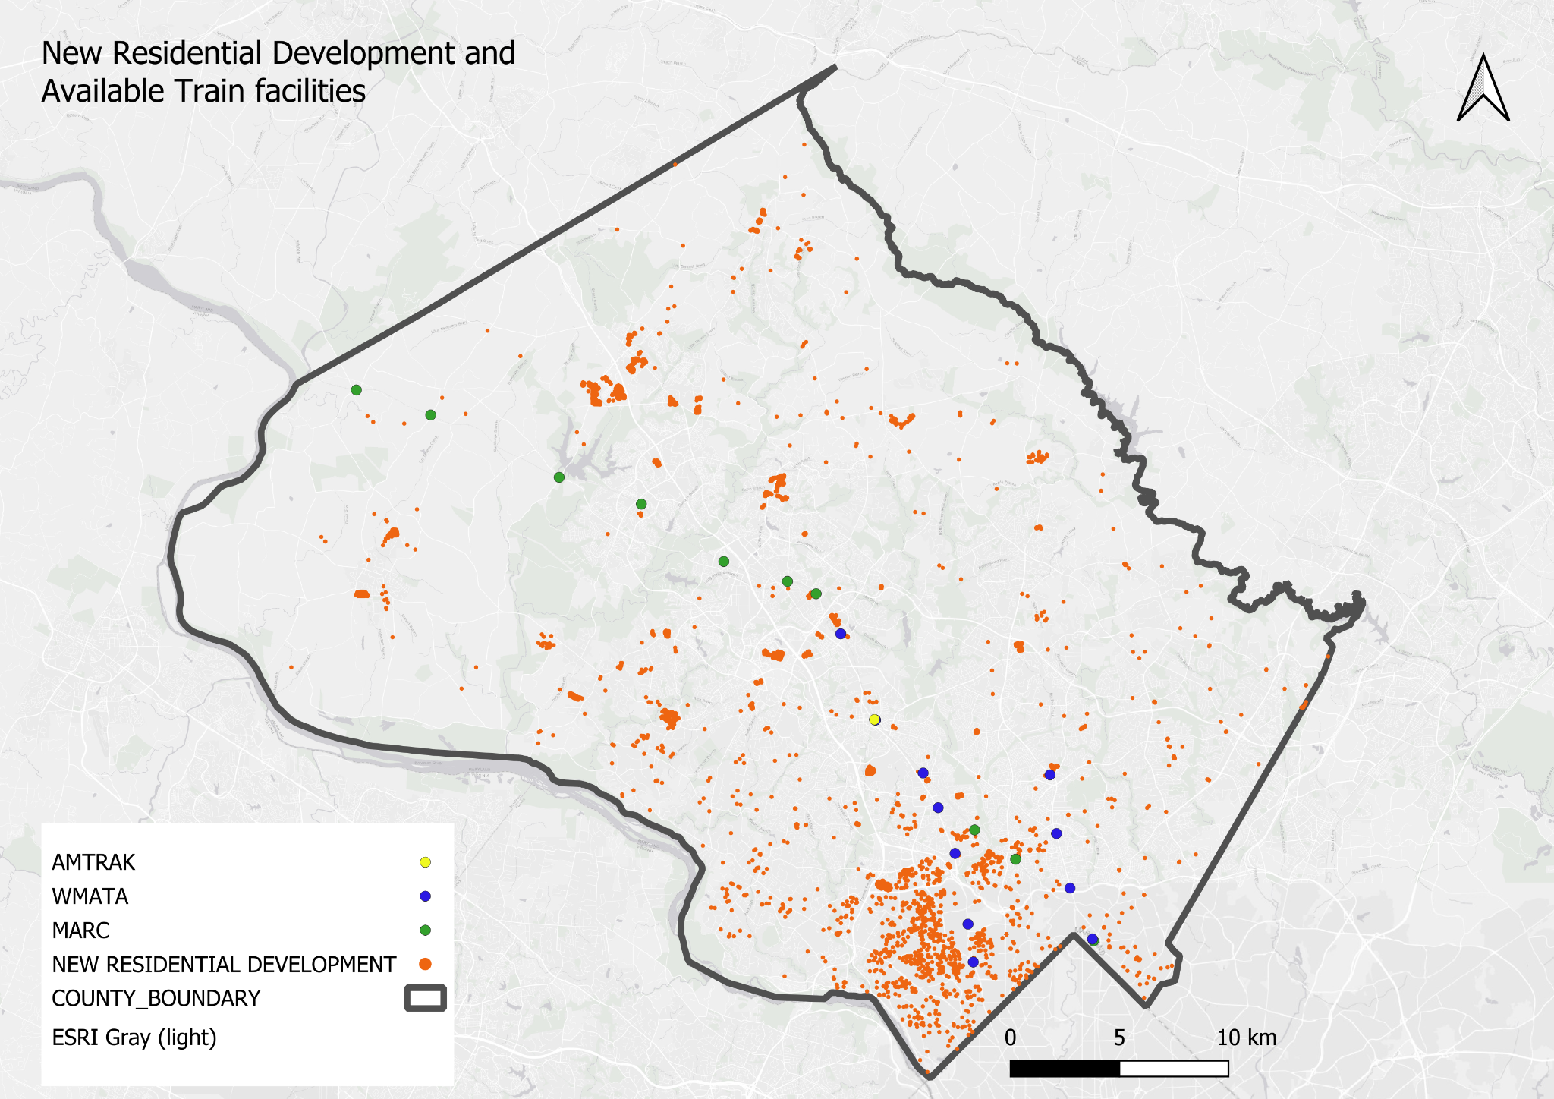
Train Facilities in Montgomery County
This map shows newly developed residential parcels overlaid with train transit infrastructure in Montgomery County. The distribution highlights proximity between many new developments and regional rail options, including MARC, AMTRAK, and WMATA stations.
Train Facilities in the County:
MARC: 11 stations
AMTRAK: 1 station
WMATA: 11 stations

Slide 7
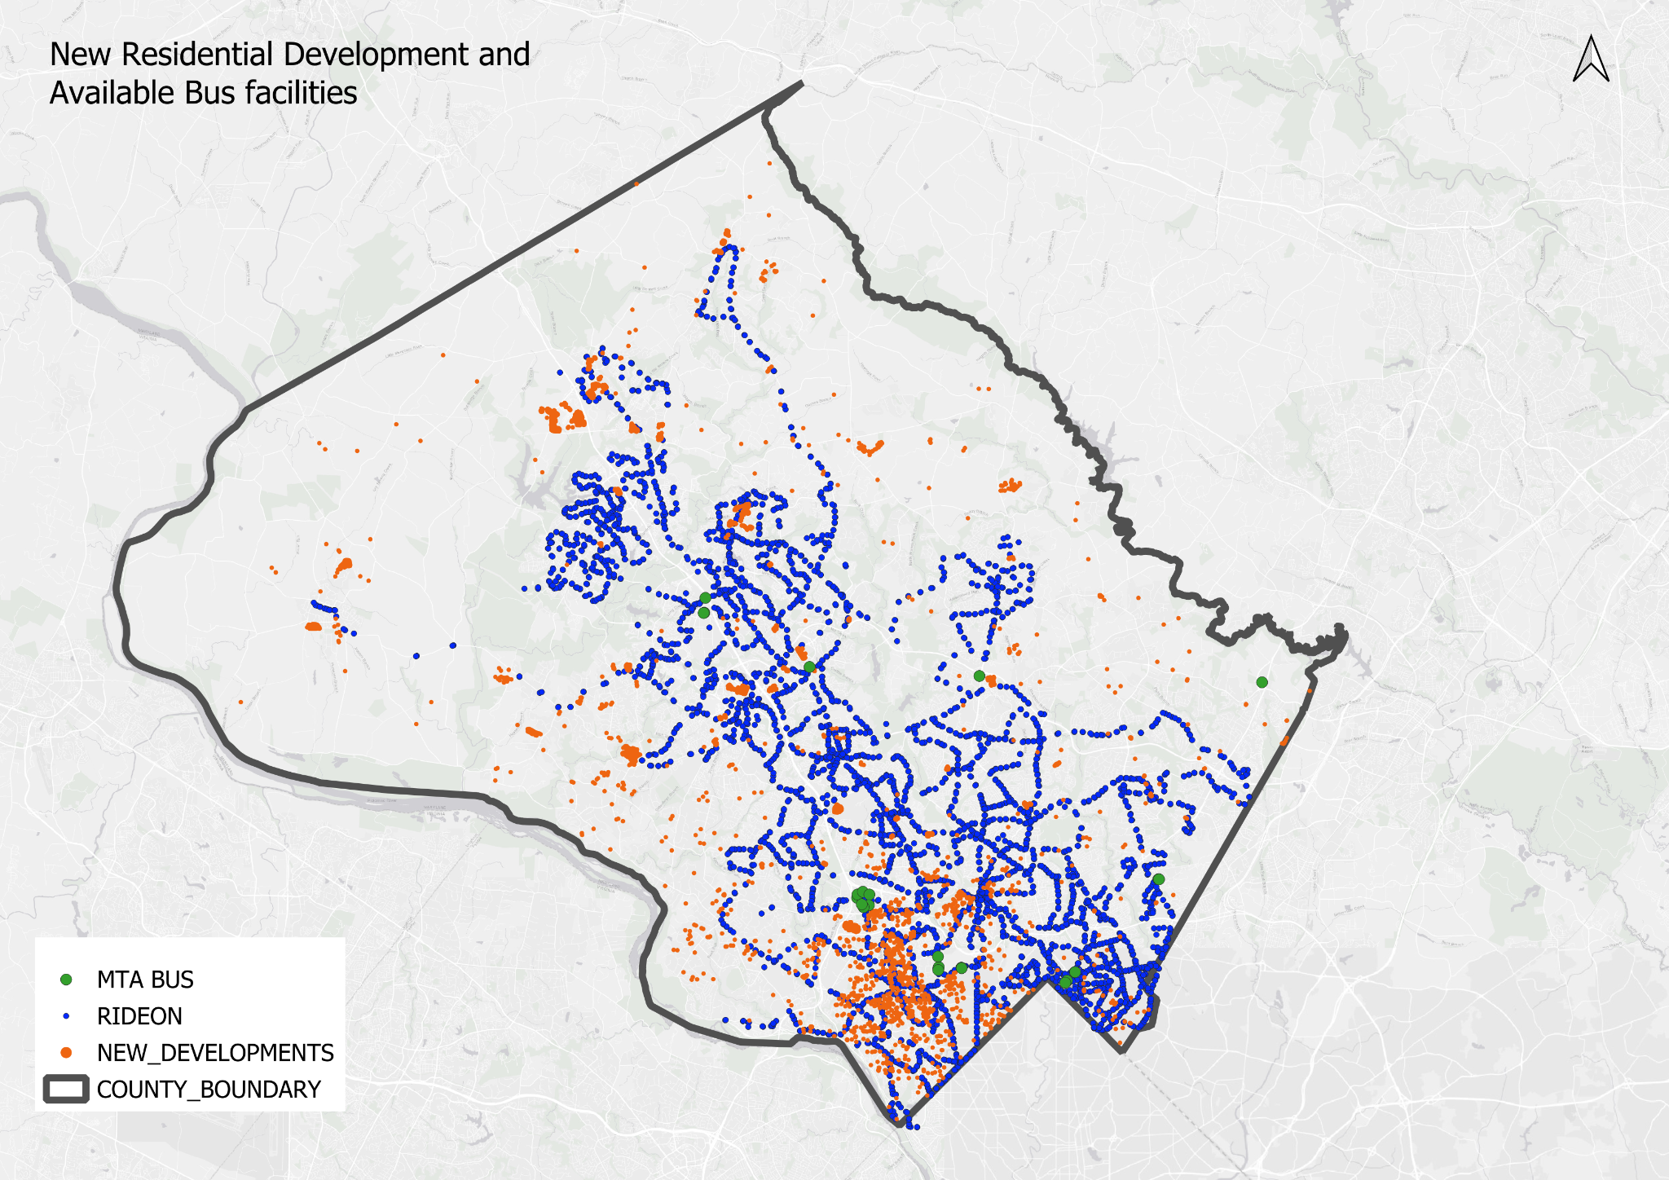
This map shows how new residential developments align with existing bus infrastructure in Montgomery County. Most developments benefit from the dense local RideOn network, while MTA’s regional service remains limited, providing minimal state-level connectivity to these newly developed areas.
Bus Facilities in the County:
RideOn: 4,787 stops
MTA Bus: 24 stops

Slide 8
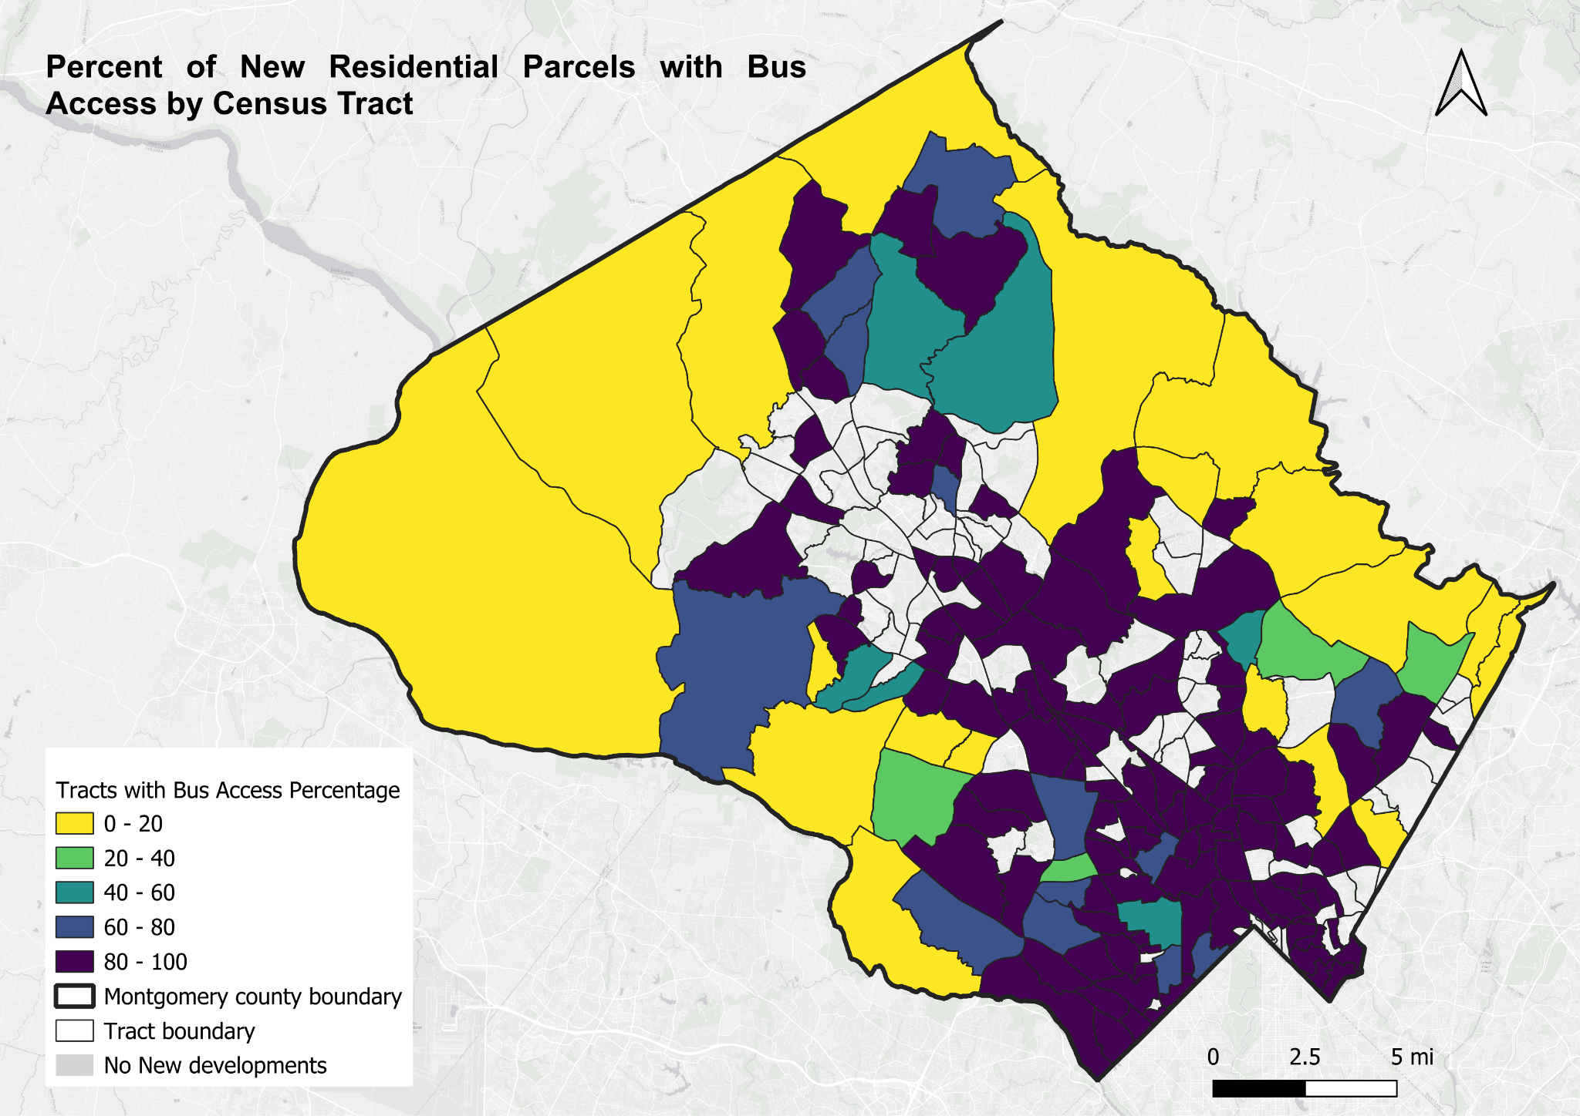
This map shows the percentage of new residential parcels with bus access by census tract in Montgomery County. Access is highest in the southern tracts, while many northern and western areas show limited or no bus coverage. White tracts indicate no new residential development.
Parcels with Bus Access: 4,672 Total New Developments: 6,376

Slide 9
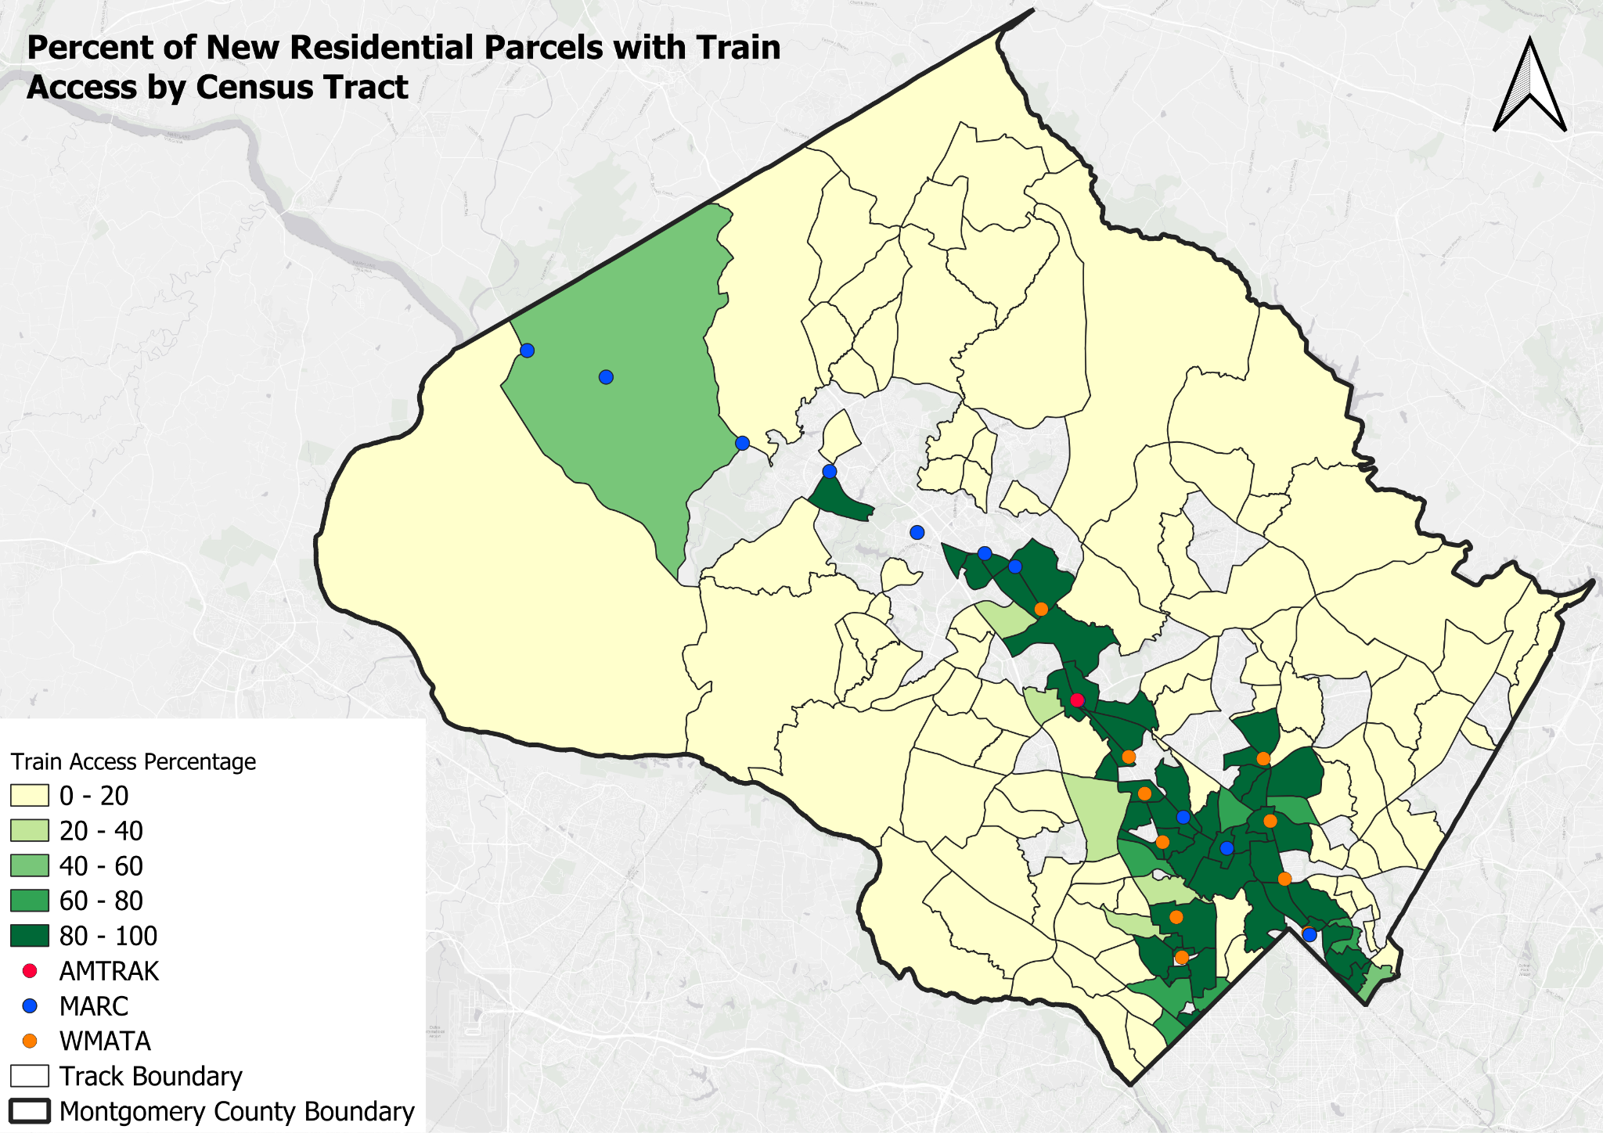
This map displays the percentage of new residential parcels with train access by census tract in Montgomery County. Most tracts show low access (0–20%, light yellow), while higher access (60–100%, dark green) is concentrated along WMATA and MARC corridors in the eastern and southern regions. Western and northern tracts lack access due to limited station coverage.
Parcels with Train Access: 1,274 Total New Developments: 6,376

Slide 10
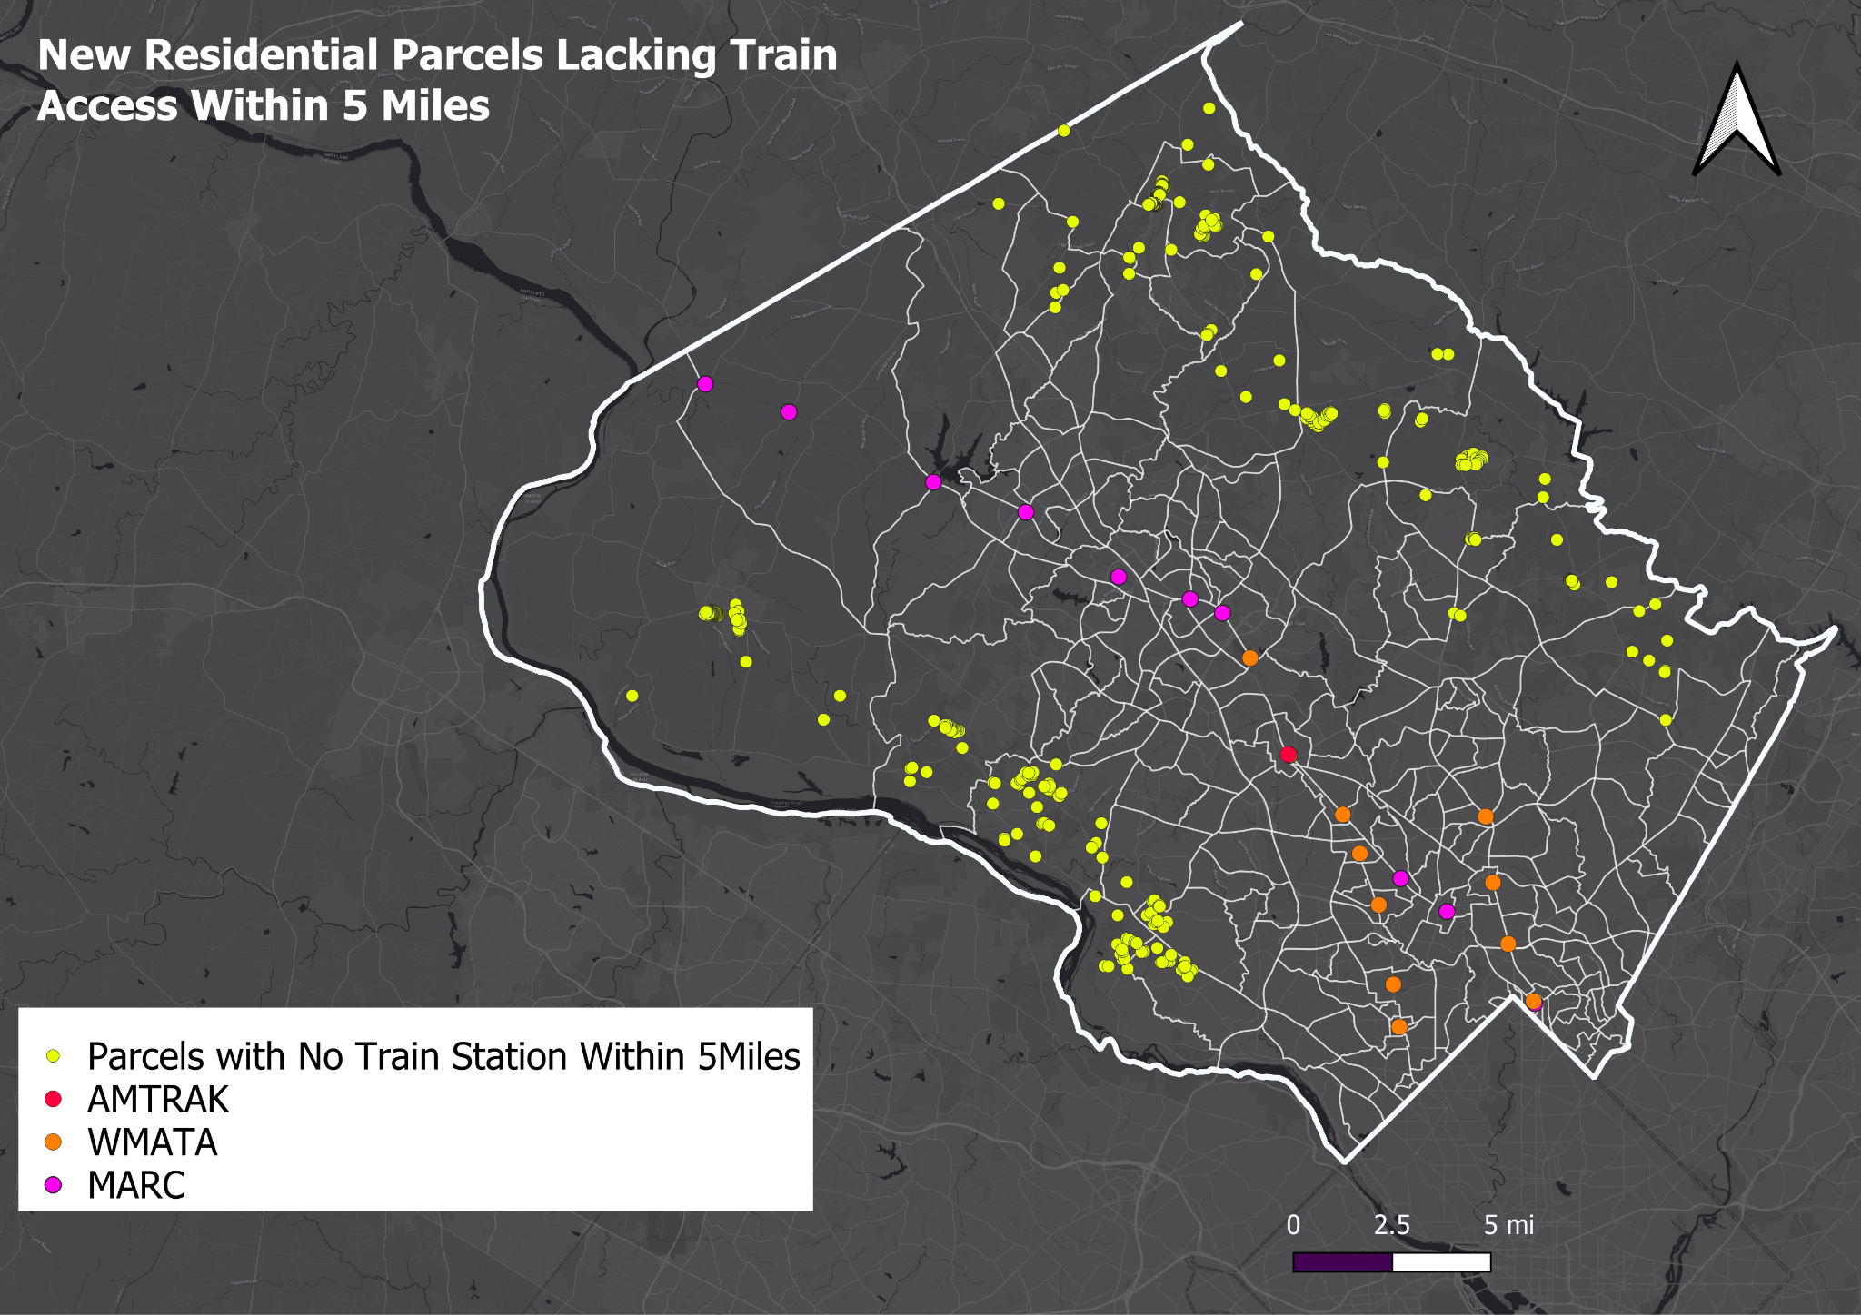
This map displays newly developed residential parcels in Montgomery County that are located more than 5 miles from the nearest train station (MARC, AMTRAK, or WMATA). These parcels lie beyond the effective reach of regional rail transit and may face limited connectivity to major employment centers and regional hubs.
Parcels Beyond 5 Miles from Train Access: 457

Slide 11
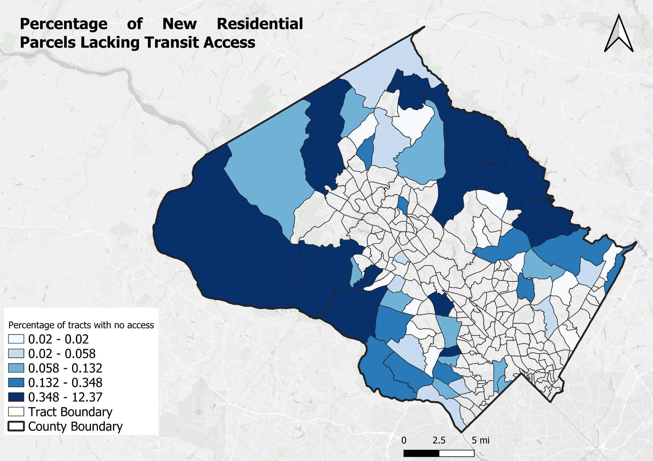
This map highlights census tracts where none of the newly developed residential parcels have access to bus or train transit within the defined distance thresholds. These areas indicate potential gaps in the public transportation network and can guide future planning efforts toward more equitable transit service coverage.
Parcels Without Any Transit Access: 1,653

Slide 12
Conclusion
Built a normalized spatial PostGIS database with well-organized schemas, role control, and validation rules.
Identified 6,376 new residential parcels developed since 2020 in Montgomery County.
Found that only 1,274 (≈20%) of these have access to train stations within 1 mile.
Bus access is more widespread , 4,672 parcels (~73%) are within 500m of a stop.
1,653 parcels had no transit access (bus or train) within defined thresholds.
Spatial patterns show higher access in southern and eastern tracts and lower access in the north and west.
Created tract-level views to support equity-focused transit planning.
Gained experience in ETL, spatial indexing, role-based access, and spatial SQL for real-world urban planning use.

